Slide 1
Flow in unsaturated porous media
Silvio Gumiere, Ph.D.

Slide 2
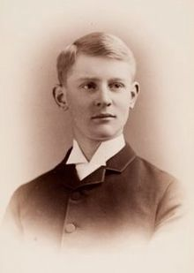
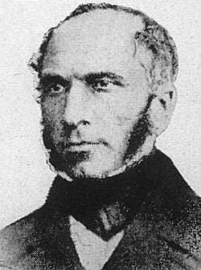
Steady flow

Slide 3
Unsaturated hydraulic conductivity

Slide 4
Unsaturated hydraulic conductivity

Slide 5
Unsaturated hydraulic conductivity

Slide 6
Steady State Unsaturated Flow
Steady-state unsaturated flow may develop under a variety of conditions.
When a constant flux at the soil surface, less than the soil's K_{s} is maintained for extended periods of time by use of a sprinkler or other means.
The evaporation rate from a shallow water table may also attain (approximately) a steady state.
For vertical steady-state unsaturated flow we may write the Buckingham-Darcy equation:
This ordinary differential equation may be integrated to yield the integral form of the Buckingham-Darcy equation (next slide).

Slide 7
Steady State Unsaturated Flow
Integral form of the Buckingham-Darcy equation:
E.g., Gardner’s Model
When K(h) has a known functional form, the integral on the left side may be evaluated exactly to produce an analytical solution for the water flux or for the distribution of the matric potential in the soil profile, h(z).

Slide 8
Steady State Unsaturated Flow
Analytical Solution for Unsaturated Steady State Flow to a Water Table:
Given a constant flux (J_{w} < K_{s}) from the soil surface to a water table at a depth L. We assume that the unsaturated hydraulic conductivity, K(h), is given by Gardner's model K(h)=K_{s} e^{βh}
We want to find the distribution of soil matric potential in the soil profile from the soil surface to the water table.
The first step is to introduce the parametric expression of K(h) into the integral form of the Buckingham-Darcy law

Slide 9
Steady State Unsaturated Flow
We set z=0 at the soil surface, and z=-L at the water table (where h=0). From a table of integrals we find the following solution:
Applying this solution to our problem with the appropriate boundary conditions yields:
Rearranging and log-transforming yields the desired form in terms of h(z):
One can verify that at z=-L, h(z=-L)=0. The term in the square brackets is limited to values between 0 and 1. This is important for analyses of maximal upward flow from a water table.

Slide 10
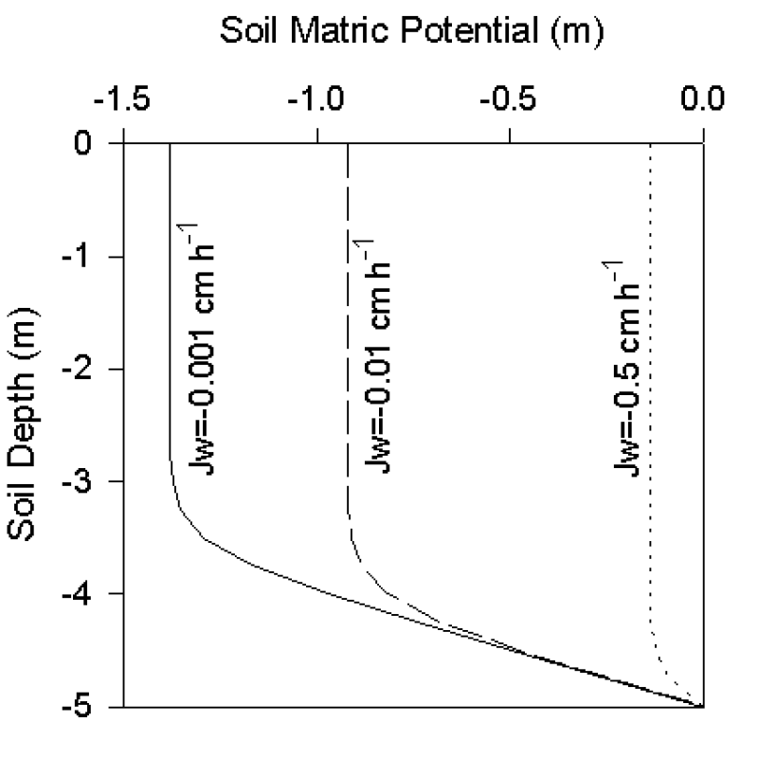
Steady State Unsaturated Flow
Graph showing matric potential distributions within the soil profile for various potentials (previous equation).

Slide 11
Steady State Unsaturated Flow - Example
Problem Statement:
Compute and plot the vertical distributions of the soil matric potential under steady flow into a water table at a depth of 3 m from the surface for the flow rates of J_{w}/K_{s}= -0.001, -0.01, -0.1, and -0.5. Note that the sign of the downward flux is negative. The unsaturated hydraulic conductivity of the soil is based on Gardner's (1958) model, and is characterized by β=5 m⁻¹.
Estimate the hydraulic gradient (dH/dz) from 0 to 1m below the soil surface.
Solution:
The depth dependent matric potential may be calculated according to the following relationship:
Results are listed on the next slide.

Slide 12
Steady State Unsaturated Flow - Example
Tabulated Results:

Slide 13
Steady State Unsaturated Flow - Example
Solution – Graph:

Slide 14
Steady State Unsaturated Flow - Example
Solution - Continued:
To estimate the hydraulic gradient we have to solve:

Slide 15
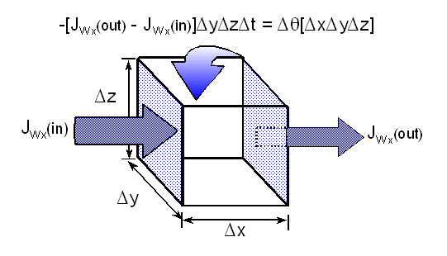
Unsteady and Unsaturated Flow –The Richards Equation

Slide 16
Unsaturated Nonsteady Flow
Unsaturated nonsteady flow is the most common flow regime under field situations, where water content θ, the matric potential h, and the flux J_{w} vary in time and space.
The application of Buckingham-Darcy's law to describe the flow is no longer sufficient as the flux varies from one location to another, a condition called flux divergence.
The difference between the flux entering a volume element of soil and that exiting the same volume element is the change in water content, or storage (CONSERVATION OF MASS = CONTINUITY PRINCIPLE).

Slide 17
The Richards Equation
The principal of continuity may be formalized mathematically for one-dimensional vertical flow as:
Note that the partial derivatives indicate possible variations of flux and water content in space and in time.
The three-dimensional form of the continuity equation is given as:
del operator
(gradient of J)

Slide 18
Unsaturated Nonsteady Flow – Richards Equation
To obtain a flow equation for unsaturated nonsteady flow we have to combine Buckingham-Darcy's law for the flux (J_{w}) with the continuity equation.
For one-dimensional vertical flow we obtain:
For three-dimensional flow we obtain:
This equation is known as the RICHARDS EQUATION, and is the most general unsaturated flow equation used in practice.
Note that this equation is based on the assumption of isothermal conditions (uniform temperature) and flow through a rigid matrix (no swelling or shrinking of the soil).

Slide 19
Unsaturated & Unsteady Horizontal Flow
Unsaturated and nonsteady horizontal flow in one dimension may be represented by the simplest form of the Richards equation, with no gravitational component, as:
In this case we have two variables, θ and h, which vary in time and space, but only one equation.
In some cases it is possible to reduce the equation to only one variable by using the interrelationship θ−h (the SWC curve).
For water infiltration into a homogeneous soil having uniform initial water content it is advantageous to eliminate the matric potential (h).

Slide 20
Unsaturated Nonsteady Horizontal Flow
We first apply the chain rule to the matric potential gradient to obtain:
Reciprocal of the
SPECIFIC WATER CAPACITY C_{w}(θ)
C_{w}(θ) is the slope of the SWC curve at any particular water content.
Next we express K(h[θ]) = K(θ), and define a new hydraulic function, the Soil Water Diffusivity D(θ) as:
The Soil Water Diffusivity is the ratio of unsaturated hydraulic conductivity to the specific water capacity.

Slide 21
Unsaturated Nonsteady Horizontal Flow
Soil Water Diffusivity D(θ):
Since the K(θ) and C_{w}(θ) functions are highly nonlinear, the diffusivity is also nonlinear. However, the range of variation in D(θ) is much smaller than the range of K(θ) variation because the nonlinearity in numerator and denominator cancel out to some degree. The resulting water content or diffusivity form of the Richards equation for one dimensional horizontal flow is then:
The driving force is the gradient in water content
“water concentration”
This is not in accordance with the basic physical principle of flow occurring due to potential gradients !!
Special care is required when applying the diffusivity form of the Richards equation!!

Slide 22
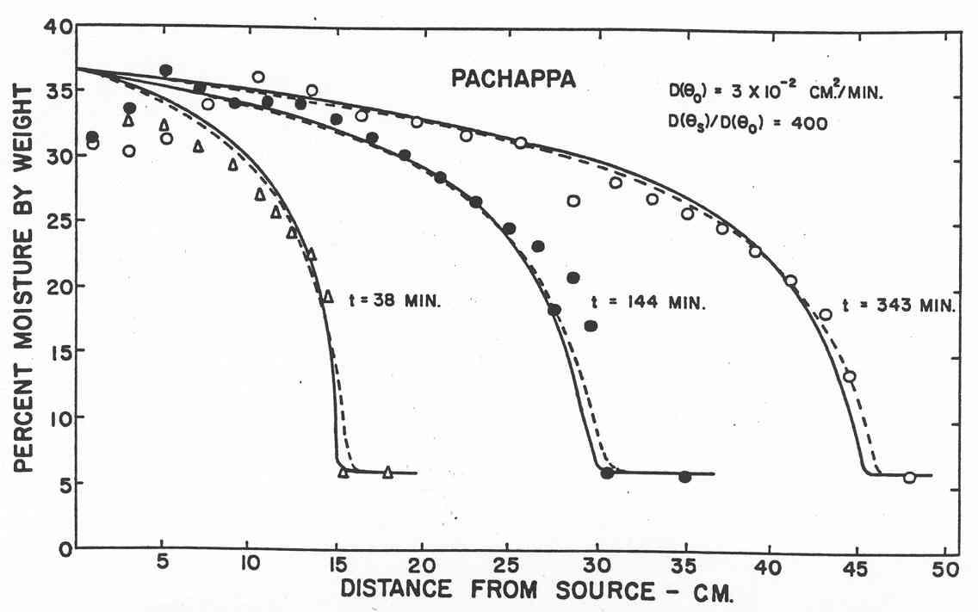
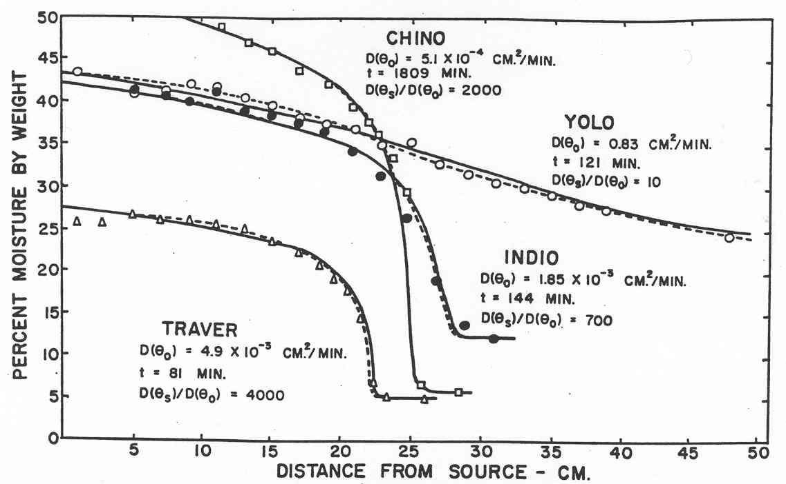
Unsaturated Nonsteady Horizontal Flow

Slide 23
Unsaturated Nonsteady Horizontal Flow
Graphical presentation of the K(θ), C_{w}(θ), and D(θ) functions
K(θ)
C_{W}(θ)
D(θ)

Slide 24
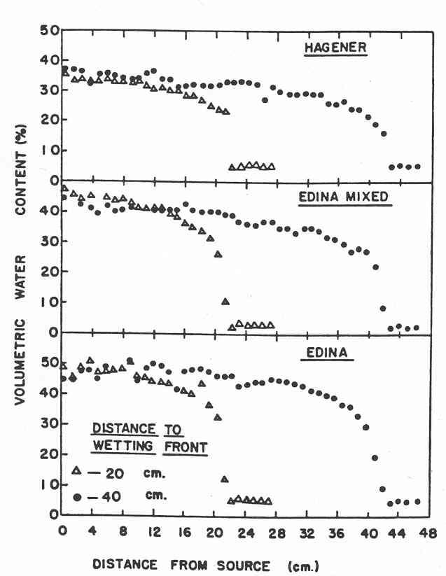
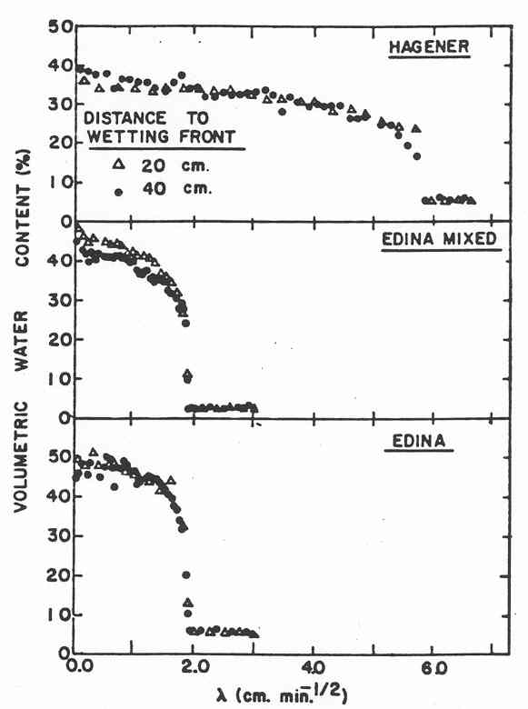
Boltzmann transformation for horizontal flow

Slide 25
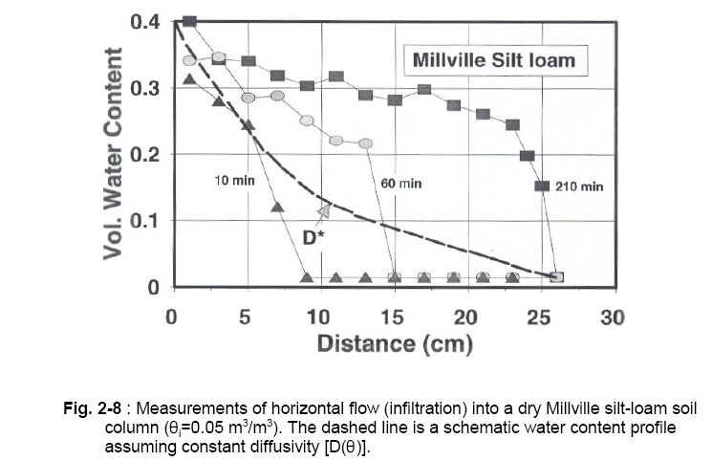
ODE for Unsaturated Nonsteady Horizontal Flow
Analytical solution with constant diffusivity D(θ)=D:

Slide 26
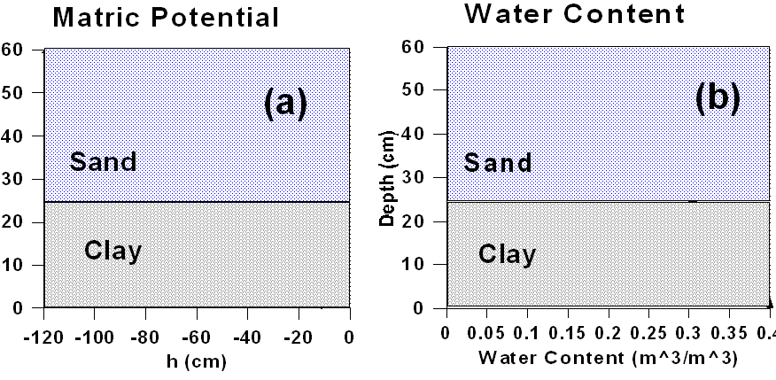
Diffusivity Form of the Richards Equation
Special care is required when applying the diffusivity form of the Richards equation!!
It should be applied only to homogeneous soils, where there is a unique relation between h and θ, neglecting hysteresis, and to describe horizontal flow where there is no gravitational component.
What happens in layered soils?
We cannot apply diffusivity form of Richards equation!!
(the derivative ∂θ/∂x is not defined across the discontinuity)
Matric potential is continuous across layers
Water Content is discontinuous across layers

Slide 27
Diffusivity Form of the Richards Equation
The diffusivity form of Richards equation is applicable:
In homogenous soils for conditions where the vertical gravitational component is very small in comparison with matric influences (translated into a water content "gradient").
Examples:
Early phases of infiltration into relatively dry soil,
Evaporation of water from the soil surface.
For special cases the diffusivity may be assumed as constant over a small range of water content.
This facilitates analytical solutions of the Richards equation.

Slide 28
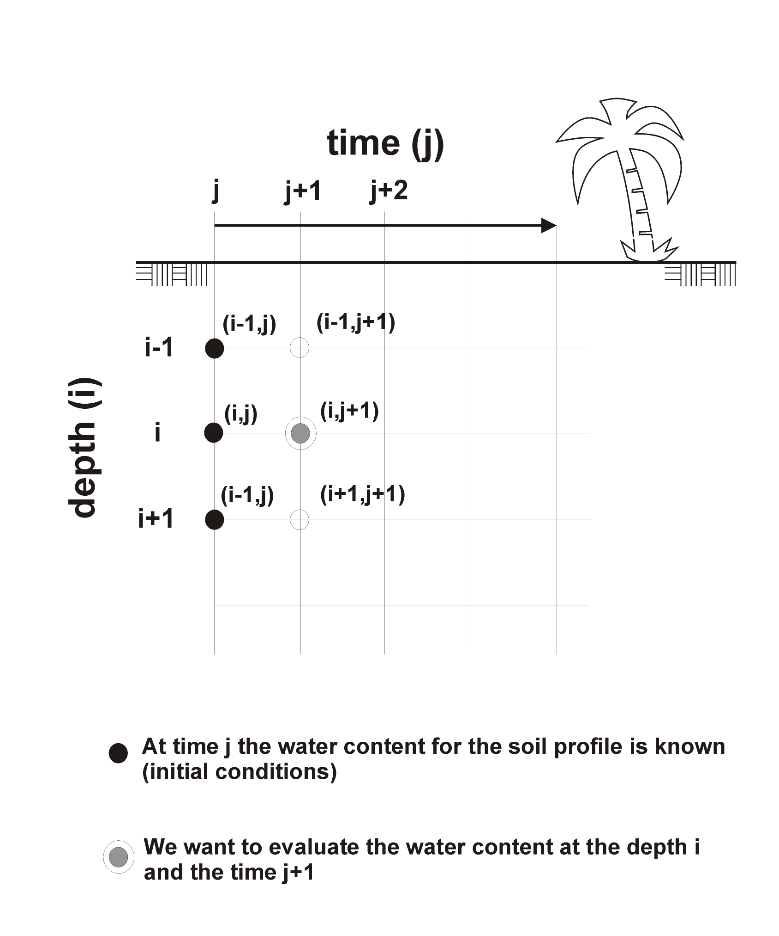
Numerical Solutions of Richards Equation
The high degree of nonlinearity in the coefficients of the Richards equation for unsaturated flow makes it impractical to obtain analytical solutions.
It might be considered as one of the most challenging equations in environmental physics (considerably different than flow of heat or electricity).
Except for a few special cases, obtaining solutions to practical flow problems represented by the Richards equation is feasible by means of successive numerical approximations, generally using computers.

Slide 29
Numerical Solutions of Richards Equation
Numerical Approximations (Finite Difference Method) are based on:
Discretization of the flow domain into a grid: "layers" for one dimensional flow or a mesh for two-dimensional flow.
Discretization of the continuous partial differential equation into a series of approximated difference equations, one for each of the spatial nodes.
Application of initial and boundary conditions.
Formulation of the problem into a computer code which is able to solve the equations for the entire flow domain at various time steps.

Slide 30
Numerical Solutions of Richards Equation
Example: A Numerical Approximation to the Richards Equation
Find a numerical approximation to changes in water content with time under vertical unsaturated and nonsteady flow into a soil with a known initial water content, and known hydraulic functions θ(ψ) and K(ψ).
Solution: We first discretize the soil profile (the spatial domain) into units of Δz, and the time into units of Δt. We denote the water content at the i-th depth increment and at the j-th time step as θ_{i}^{j}; similarly we express the corresponding matric head as h_{i}^{j} (see graph previous slide) The hydraulic conductivity, which is a function of the matric head (or of the water content), relates transfer between two soil layers and thus must be averaged to represent both layers as: K([h_{i}^{j} + h^{j}_{i+1}]/2) = K^{j}_{i+1}/2. The resulting numerical approximation for Buckingham-Darcy’s law for vertical flow is then given by:

Slide 31
Numerical Solutions of Richards Equation
Example – continued:
Combining terms and rearranging allows us to solve for the only unknown in this equation, which is θ_{i}^{j}+1, the water content for the i-th depth increment at the next (future) time step:
Because this is a discrete approximation of a continuous process, increments Δz and Δt should be kept small. In addition, initial soil water contents with respect to depth and the conditions at the boundaries of the flow domain need to be specified.

Slide 32
HYDRUS

